Slide 1

CHESS FIDE RANKINGS
BY
Lanka srinivasudu

Slide 2
INTRODUCTION
Welcome to our project focused on the Exploratory Data Analysis (EDA) of Chess Player Statistics.
In this exploration, we delve into the intricate realm of chess, aiming to unravel insights and patterns concealed within the data.

Slide 3
LEARNING OUTCOMES
Data Cleaning and Preprocessing:
Exploratory Data Analysis (EDA):
Data Visualization:
Python Programming for Data Analysis:
Learning Outcomes:

Slide 4

PROJECT
This project delves into the FIDE TOP 200 Chess Rankings dataset, aiming to unravel insights from the elite chess realm. By analyzing key attributes such as player rankings, Elo ratings, titles, and federations, the exploration provides a comprehensive understanding of the global chess landscape.
Through data cleaning, statistical analysis, and visualizations, the project seeks to uncover patterns, trends, and unique characteristics within the dataset. The outcomes promise to contribute to chess enthusiasts' knowledge, providing a valuable resource for players, analysts, and researchers interested in the dynamics of top-ranked chess players worldwide.

Slide 5

Objective:
The primary objective of this project is to conduct Exploratory Data Analysis (EDA) on the FIDE TOP 200 Chess Rankings dataset. Through this analysis, we aim to unearth patterns, trends, and insights that contribute to a comprehensive understanding of the global chess landscape.
The project seeks to answer key questions and provide valuable visualizations that can benefit chess enthusiasts, analysts, and professionals in the chess domain
Dataset Overview:
The dataset encompasses crucial details such as player rankings, Elo ratings, titles (e.g., Grandmaster), federations, total games played, birth years, intrarankings, and active status.

Slide 6

METHODOLOGY
Data Cleaning: Ensuring the dataset's integrity by handling missing values, correcting inconsistencies, and preparing the data for analysis.
Descriptive Statistics: Calculating summary statistics to gain an initial understanding of the dataset.
Visualizations: Utilizing various charts and graphs to visually represent key insights and trends within the data.
Hypothesis Testing (if applicable): Exploring hypotheses related to player performance, regional dominance, or other intriguing aspects of chess dynamics.

Slide 7
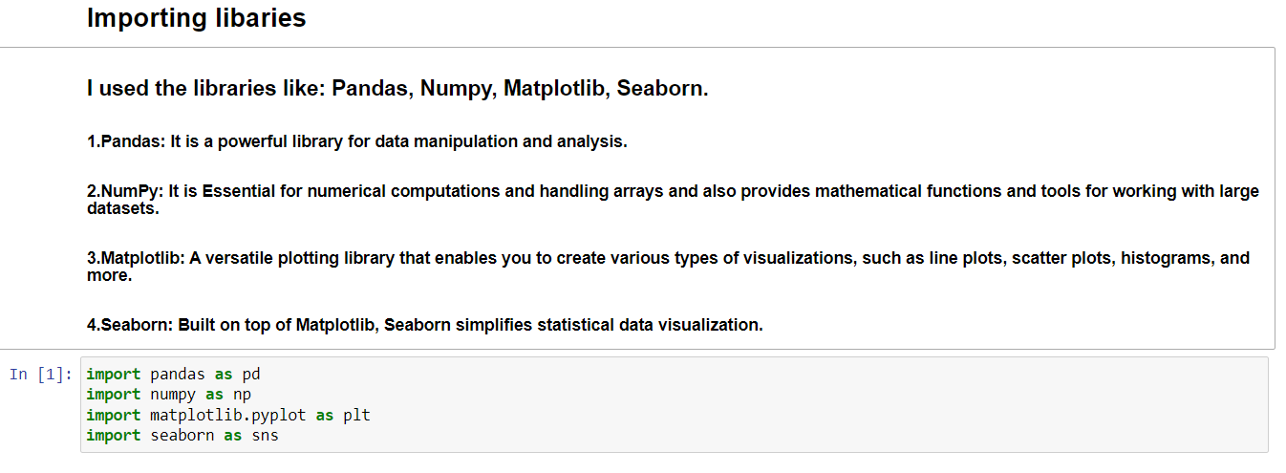
Exploratory Data Analysis (EDA) and Data Visualization

Slide 8
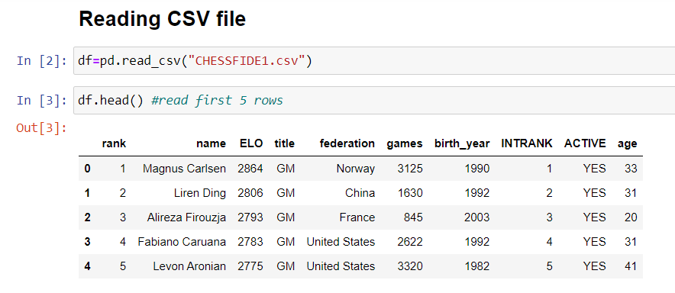
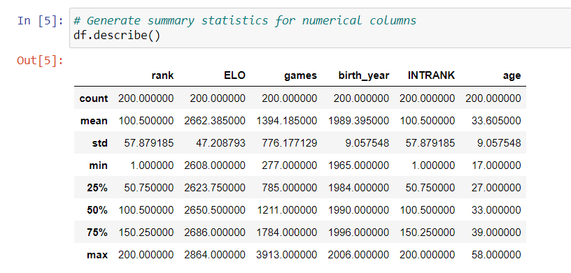

Slide 9
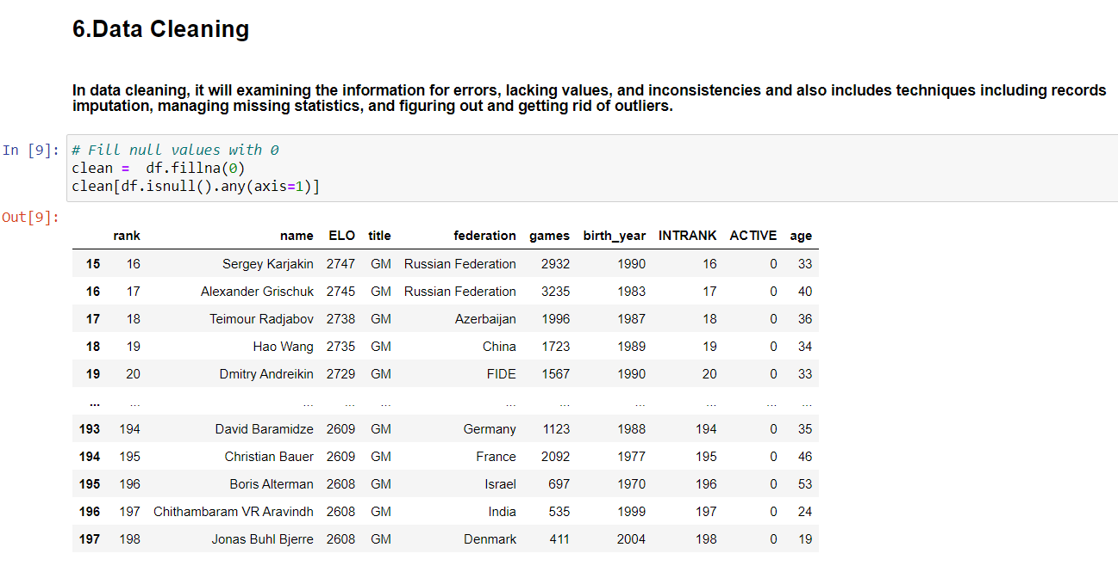

Slide 10
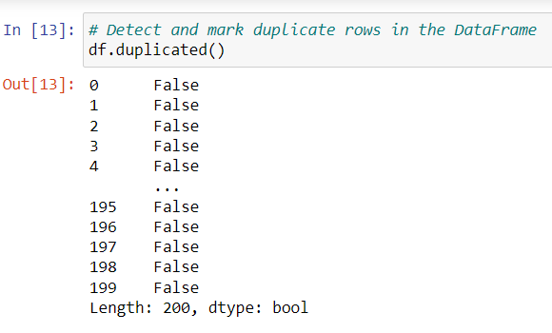
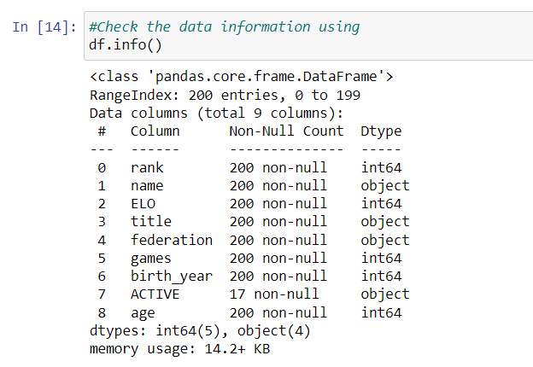

Slide 11
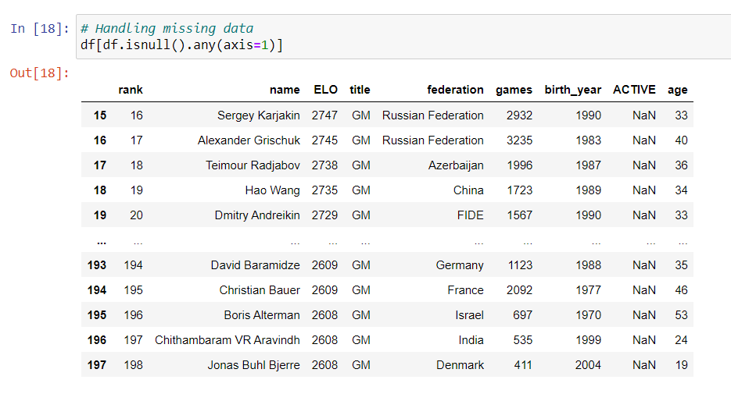

Slide 12

DATA VISUALIZATION

Slide 13
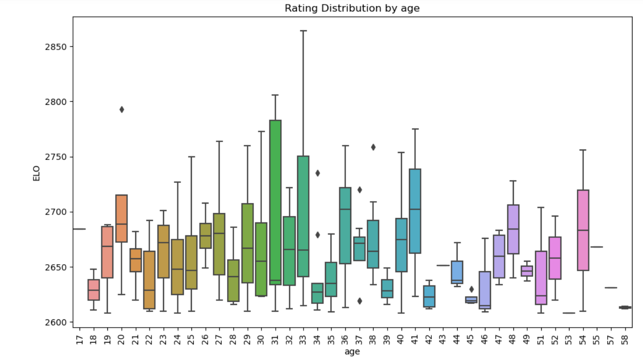
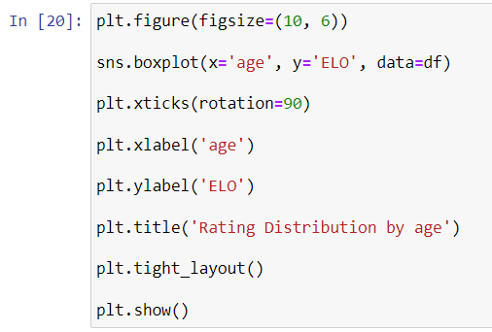
BOX PLOT

Slide 14
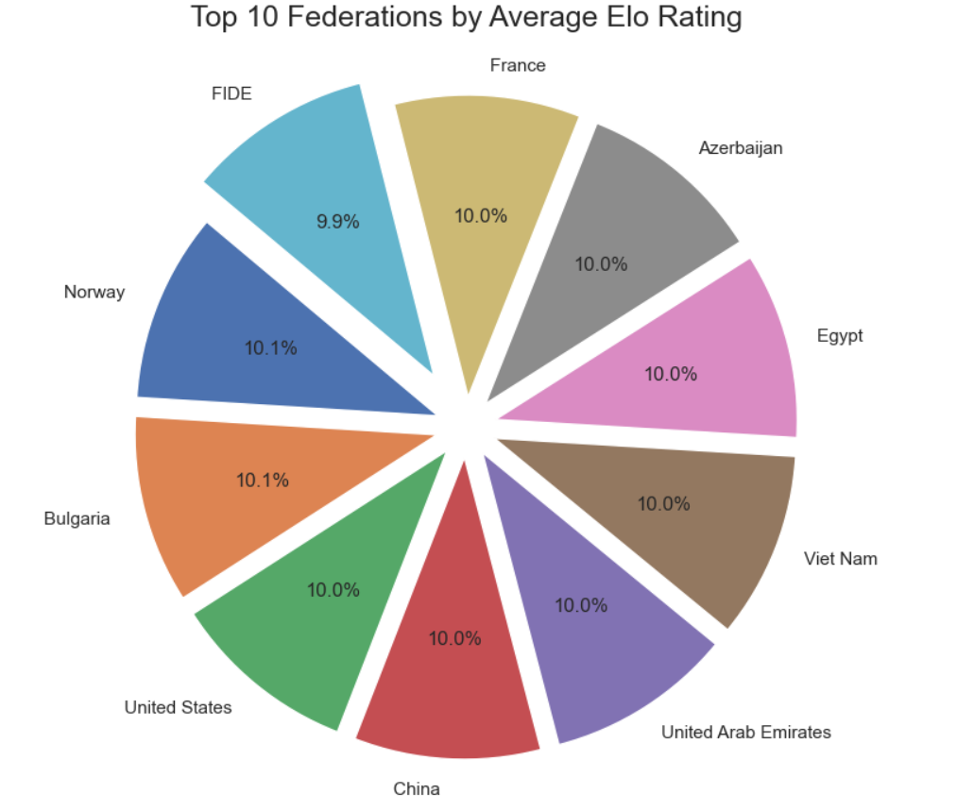
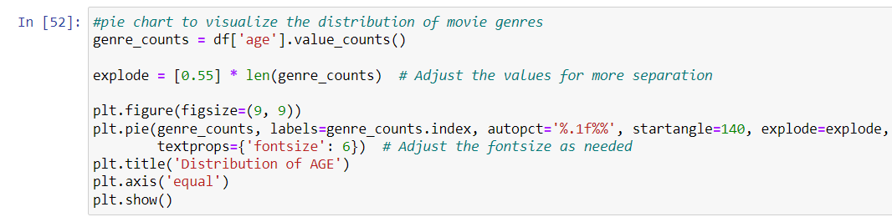
PIE CHART

Slide 15
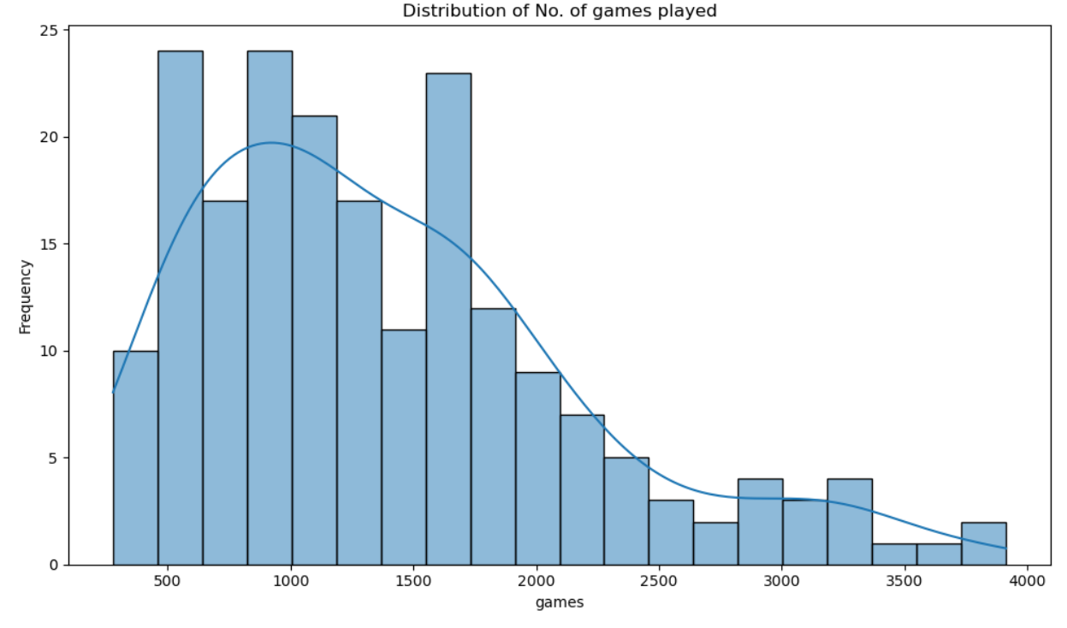
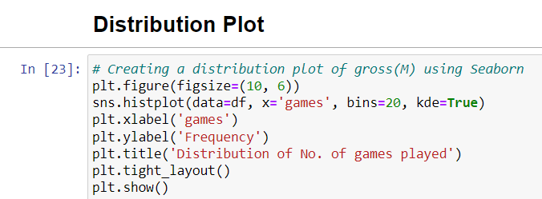
DISTRIBUTION PLOT

Slide 16
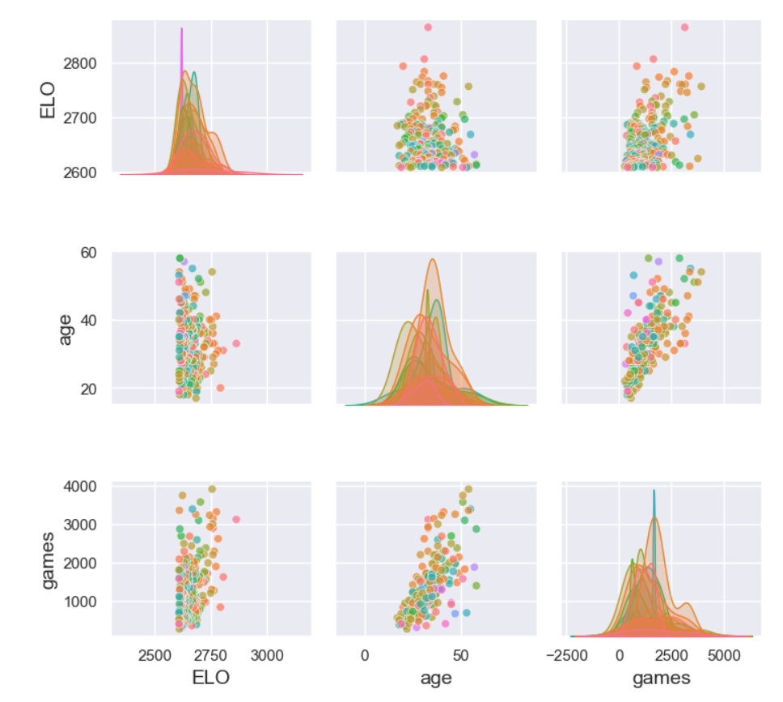
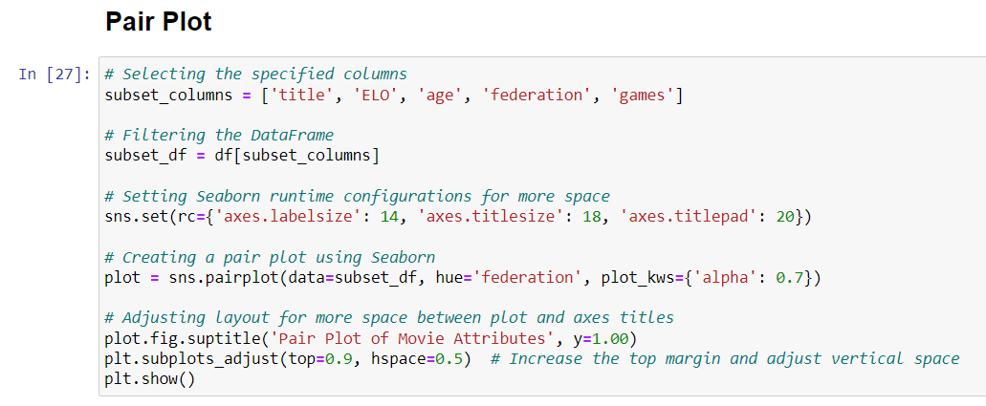
PAIR PLOT

Slide 17
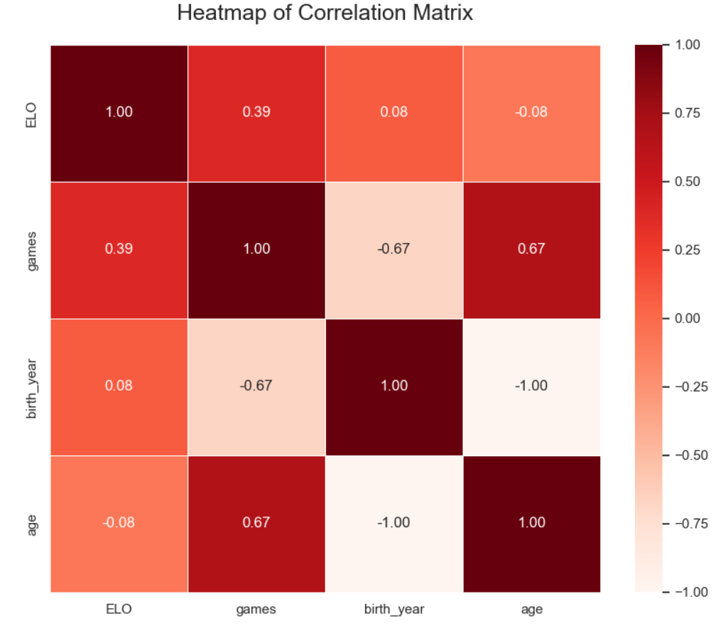
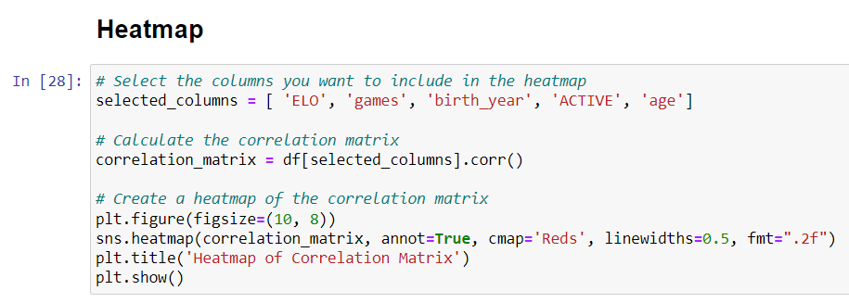
HEATMAP

Slide 18

DISTRIBUTIONS

Slide 19
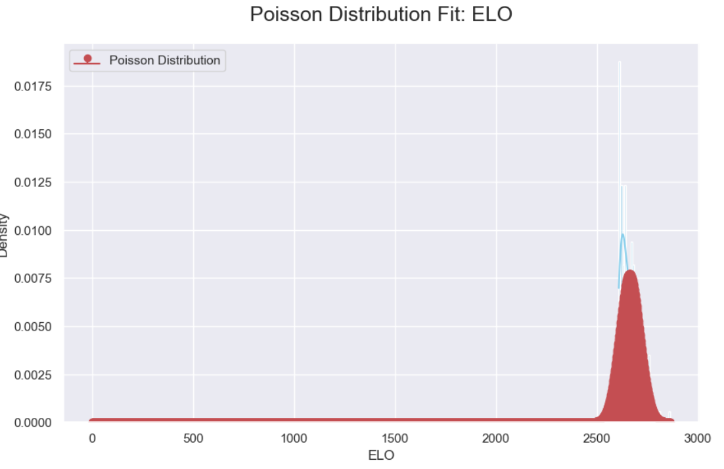
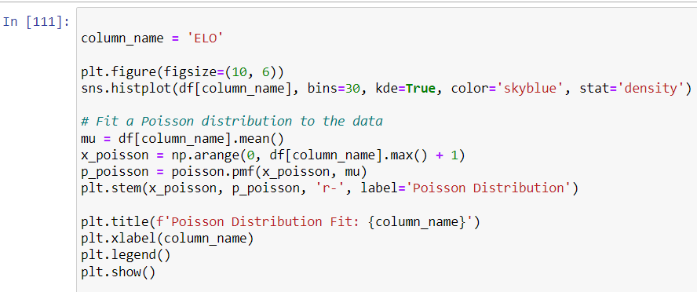
POISSON DISTRIBUTION

Slide 20
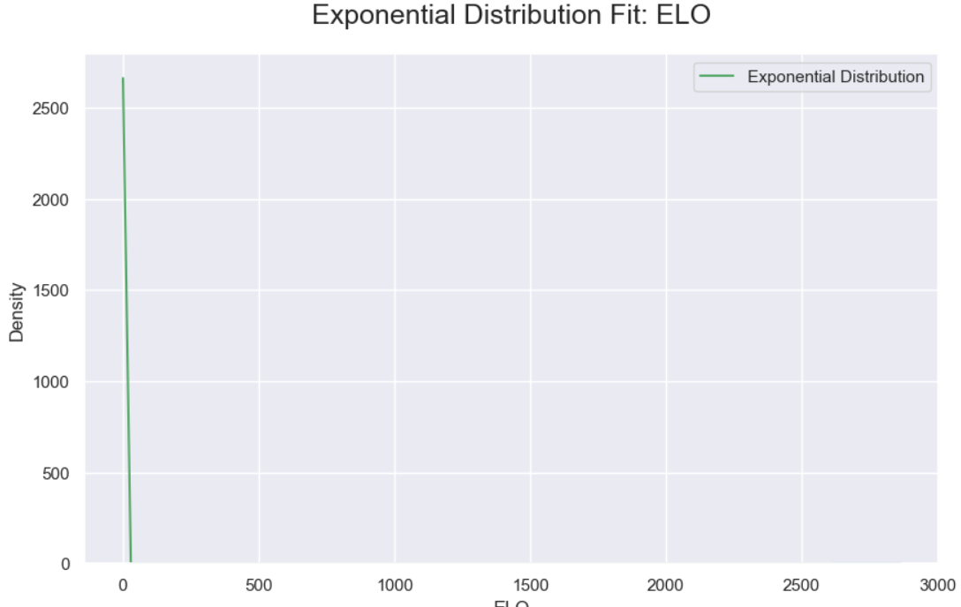
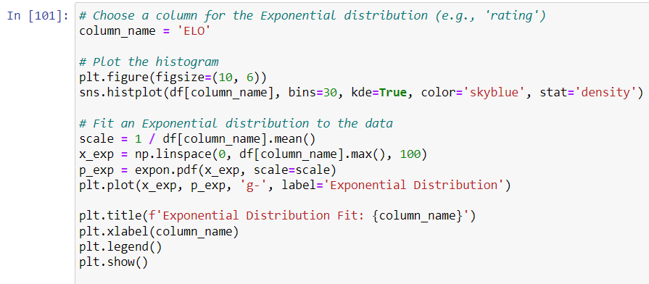
EXPONENTIAL DISTRIBUTION

Slide 21
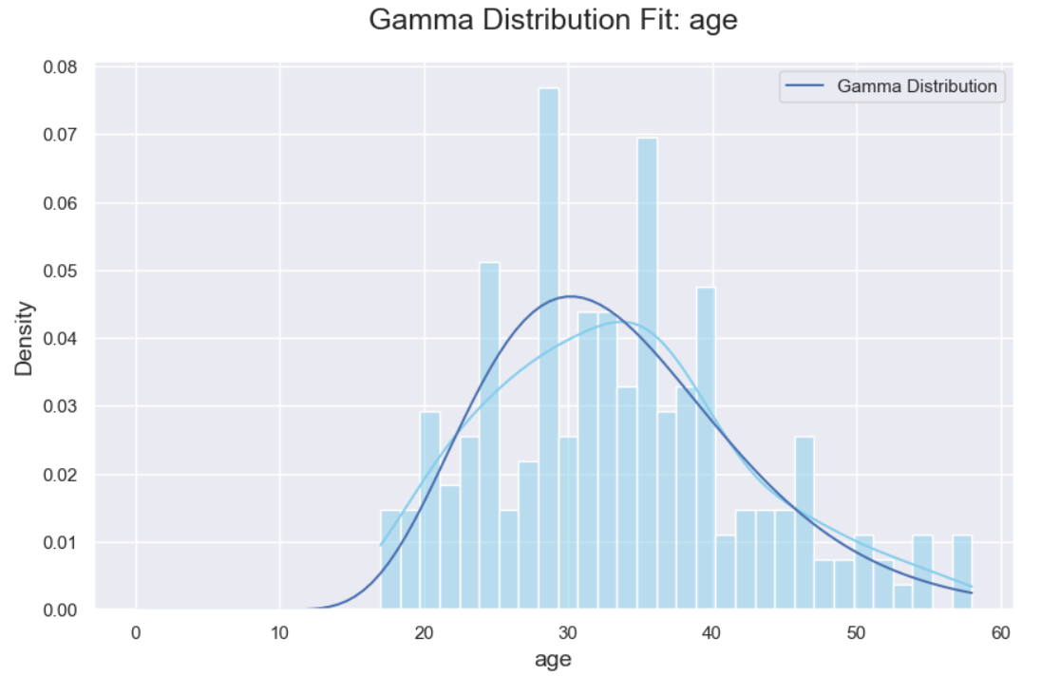
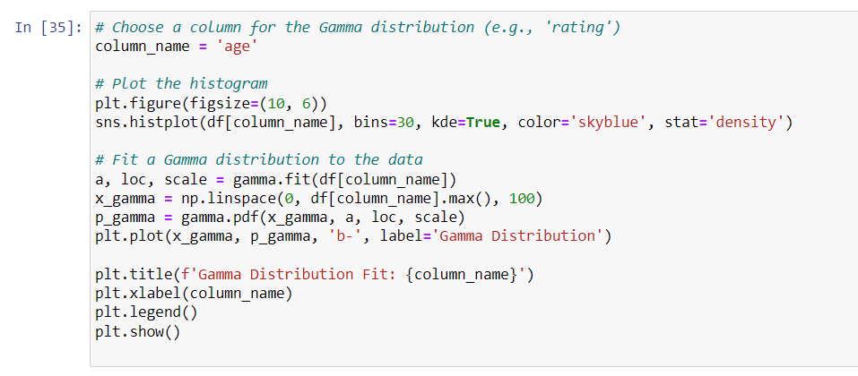
GAMMA DISTRIBUTION

Slide 22
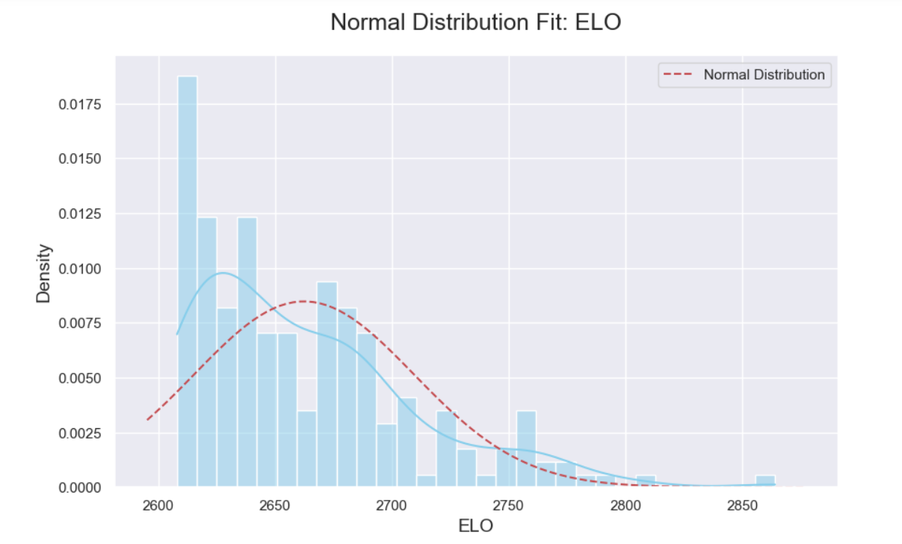
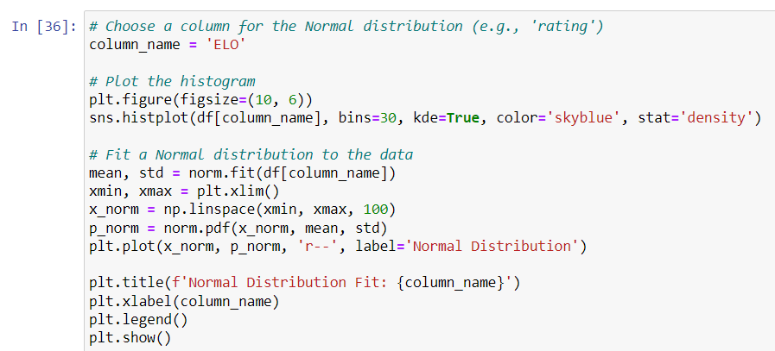
NORMAL DISTRIBUTION

Slide 23

HYPOTHESIS TESTING

Slide 24
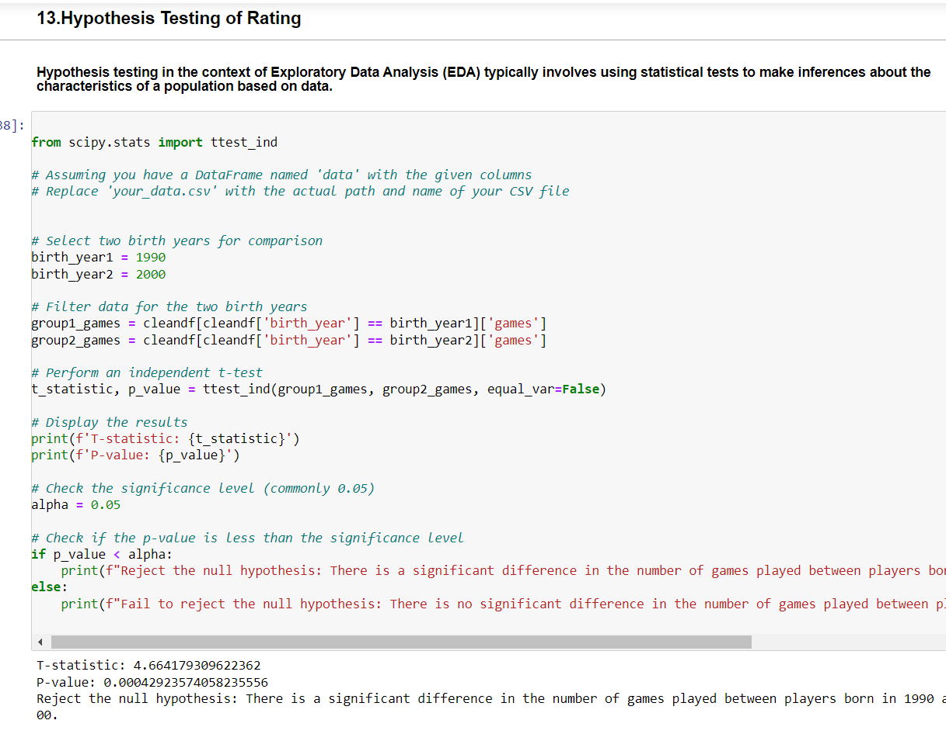
HYPOTHESIS TESTING

Slide 25

THANK YOU

